Slide 1
CBOE Financial Network
Book Depth for OneChicago™ Futures Markets

Slide 2
Book Depth Update Approach
Book Position
  Uses Book Position to establish where to apply updates
  Implicit Approach
    Adding implies inserting entry at book position moving entries downward

Slide 3
Two Types of Messages and their Actions
Full Refresh (Message Category t)
  Replace entries in book with new entries
  Action = R
Update (Message Category u)
  Add new entries to book
    Implies shifting existing book positions down
    Action = A
  Update entries in book
    Change a quantity associated at a price level
    Action = U
  Delete entries from book
    Implies shifting existing book positions up
    Action = D

Slide 4
Actions are performed at a Book Position
Book Positions start at 1 for the top of the book and continue up to BOOK_SIZE number of entries

Slide 5
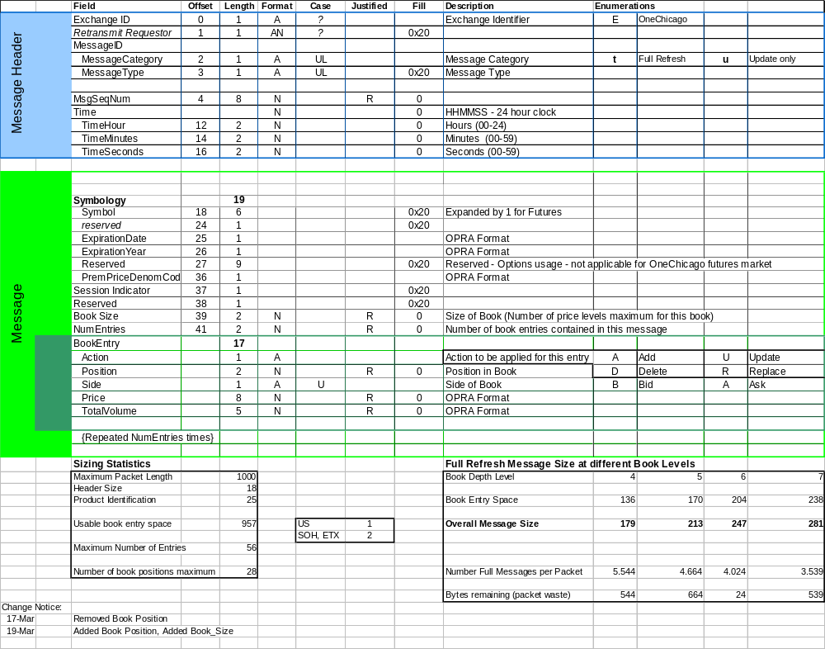
Message Format

Slide 6
Start of Day - Full Refresh Message
1. Create Book
2. Add Buy Side and Sell Side to Book
t.IBM...V3………B…0510
R01B000010000010
R02B000009500020
R03B000009000010
R04B000008500020
R05B000007500020
R01S000012500015
R02S000013000005
R03S000014000005
R04S000015500010
R05S000020000010
IBM OCT
Buy
Sell
Buy
Sell
1
1.00
10
1
1.25
15
2
0.95
20
2
1.30
5
3
0.90
10
3
1.40
5
4
0.85
5
4
1.55
10
5
0.75
20
5
2.00
10

Slide 7
Top of Book is Traded on Both Sides
1. Locate Book
3. Add new entries
u.IBM...V3………B…0510
D01B000010000010
D01S000012500015
A05B000006500020
A05S000021000010
IBM OCT
IBM OCT
Buy
Sell
Buy
Sell
1
1.00
10
1
1.25
15
1
0.95
20
1
1.30
5
2
0.95
20
2
1.30
5
2
0.90
10
2
1.40
5
3
0.90
10
3
1.40
5
3
0.85
5
3
1.55
10
4
0.85
5
4
1.55
10
4
0.75
20
4
2.00
10
5
0.75
20
5
2.00
10
5
0.65
20
5
2.10
10
2. Delete Entries at top of book
IBM OCT
Buy
Sell
Shift remaining rows up when a delete occurs
1
0.95
20
1
1.30
5
2
0.90
10
2
1.40
5
3
0.85
5
3
1.55
10
4
0.75
20
4
2.00
10
5
5

Slide 8
Portion of Top of Book is Traded on Buy Side
1. Locate Book
2. Update Entry
IBM OCT
IBM OCT
Buy
Sell
Buy
Sell
1
0.95
20
1
1.30
5
1
0.95
10
1
1.30
5
2
0.90
10
2
1.40
5
2
0.90
10
2
1.40
5
u.IBM...V3………B…0510
U01B000009500010
3
0.85
5
3
1.55
10
3
0.85
5
3
1.55
10
4
0.75
20
4
2.00
10
4
0.75
20
4
2.00
10
5
0.65
20
5
2.10
10
5
0.65
20
5
2.10
10

Slide 9
New Top of the Book - Both Sides
1. Locate Book
3. Insert Entry on Sell Side Top of Book
IBM OCT
IBM OCT
Buy
Sell
Buy
Sell
1
0.95
20
1
1.30
5
1
1.00
10
1
1.25
10
2
0.90
10
2
1.40
5
2
0.95
10
2
1.30
5
u.IBM...V3………B…0510
A01B000010000010
A01S000012500010
3
0.85
5
3
1.55
10
3
0.90
10
3
1.40
5
4
0.75
20
4
2.00
10
4
0.85
5
4
1.55
10
5
0.65
20
5
2.10
10
5
0.75
20
5
2.00
10
2. Insert Entry on Buy Side
IBM OCT
Buy
Sell
Shift existing rows down when an add occurs at a position < Book_Size
1
1.00
10
1
1.30
5
2
0.95
10
2
1.40
5
3
0.90
10
3
1.55
10
4
0.85
5
4
2.00
10
5
0.75
20
5
2.10
10

